Slide 1
SEQUENCING PROBLEMS
Processing of n Jobs Through Two Machines and m Machines,
Graphical Method of Two Jobs m Machines Problem

Slide 2
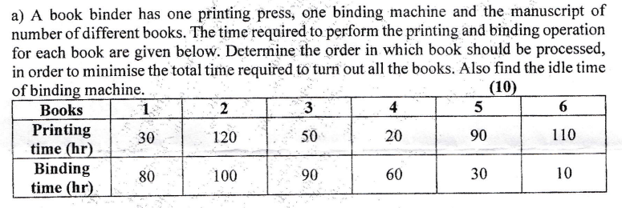
Processing of n Jobs Through Two Machines​

Slide 4
Introduction
Sequencing problems are quite common in real life. They arise whenever there is a choice of determining the order in which a number of jobs can be performed. These problems play a very important role in manufacturing set-ups for the optimal use of resources and/or the customer’s satisfaction. Many-a-times, manufacturing firms produce goods made up of several components, which are sourced from other manufacturing firms. The final product undergoes many processes before it is taken to the market for sale. Since several machines are used in the production process, it is important to sequence the production process optimally so that the performance measures of the firm are satisfied.

Slide 5
Objectives
After studying this unit, you should be able to:
explain what a sequencing problem is;
determine the appropriate order for the jobs to be done so as to minimise the elapsed time for 2-Machine, n-Job problems;
determine the appropriate order for the jobs to be done so as to minimise the elapsed time for n-Job, m-Machine problems; and
obtain the minimum elapsed times for sequencing problems.

Slide 6
SEQUENCING PROBLEMS
The selection of the appropriate order in which a number of jobs (customers) are to be performed (served) is called sequencing. In sequencing problems, there are two or more customers (jobs) to be served and one or more facilities (machines) available for this purpose. We wish to know when each job is to begin and what its due date or time is. We also wish to know which facilities are required to do each job, in which order these facilities are required and how long each operation is to take.

Slide 7
The following assumptions are usually made while dealing with sequencing problems:
Only one operation is carried out on a machine at a time.
Processing times are known and do not change.
Processing times are independent of the order of processing the jobs.
The time involved in moving jobs from one machine to another is negligible.
Each operation, once started, must be completed.
An operation must be completed before its succeeding operation can start.
Only one machine of each type is available.
A job is processed as soon as possible, but only in the order specified.
No passing rule is followed strictly, i.e., the same order of jobs is maintained over each machine.
Sequencing problems have been most commonly encountered in production shops where different products are to be processed over various combinations of machines.

Slide 8
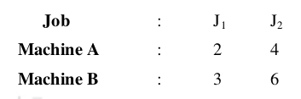
i) First process J₁ , J₂ in this order on machines A and B, respectively;
ii) First process J₁ , J₂ in this order on machines B and A, respectively;
iii) First process J₂ , J₁ in this order on machines A and B, respectively;
iv) First process J₂ , J₁ in this order on machines B and A, respectively.

Slide 9
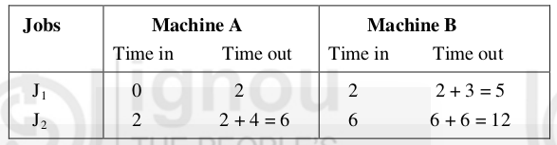
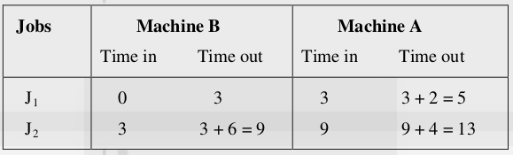
For the first sequence, the various times can be calculated as in the following table:
For the second sequence, the various times can be calculated as in the following table:
Here, the total elapsed time is 12 hours.
The idle time for machine A
= Total elapsed time - Time when the last job is out of the machine A,
= 12 – 6 = 6 hrs
The idle time for machine B
= Time of starting the first job at B
+ (Time of starting the second job at B
– time of finishing the first job at B)
= 2 + (6 – 5) = 3 hrs
Here, the total elapsed time is 13 hours.
The idle time for machine B
= Total elapsed time - Time when the last job is out of machine B
= 13 – 9 = 4 hrs
The idle time for machine A
= Time of starting the first job at A
+ (Time of starting the second job at A
– time of finishing the first job at A)
= 3 + (9 – 5) = 7 hrs

Slide 10
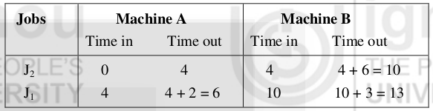
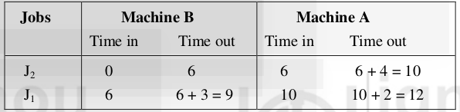
For the third sequence, the various times can be calculated as in the following table:
For the fourth sequence, the various times can be calculated as in the following table:
Here, the total elapsed time is 13 hours.
The idle time for machine A
= Total elapsed time - Time when the last job is out of the machine A
= 13 – 6 = 7 hrs
The idle time for machine B
= Time of starting the first job at machine B
+ (Time of starting the second job at machine B
– time of finishing the first job at machine B)
= 4 + (10 –10) = 4 hrs
Here, the total elapsed time is 12 hours.
The idle time for machine B
= Total elapsed time - Time when the last job is out of machine B
= 12 – 9 = 3 hrs
The idle time for machine A
= Time of starting the first job at machine A
+ (Time of starting the second job at machine A
– time of finishing the first job at machine A)
= 6 + (10 – 10) = 6 hrs

Slide 11
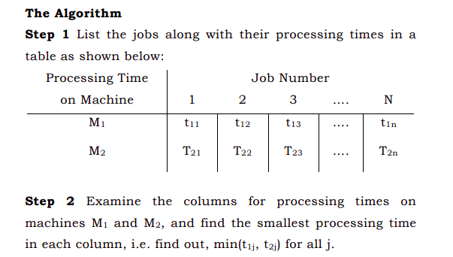
The procedure suggested by Johnson for determining the optimal sequence can be summarized as follows.

Slide 13
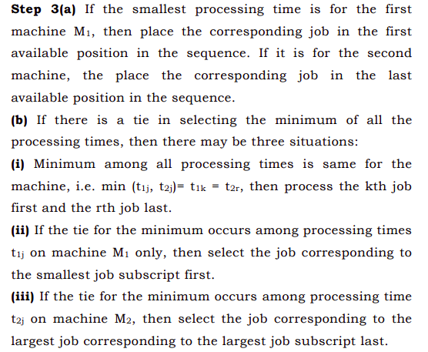
No. of jobs | 1 | 2 | 3 | 4 | 5 | 6
Machine A | 4 | 8 | 3 | 6 | 7 | 5
Machine B | 6 | 3 | 7 | 2 | 8 | 4
No. of jobs | 1 | 2 | 3 | 4 | 5 | 6 | 7
Machine A | 3 | 12 | 15 | 6 | 10 | 11 | 9
Machine B | 8 | 10 | 10 | 6 | 12 | 1 | 3

Slide 14

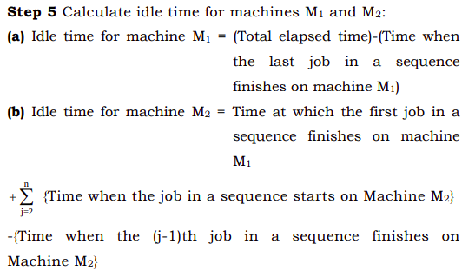

Slide 15
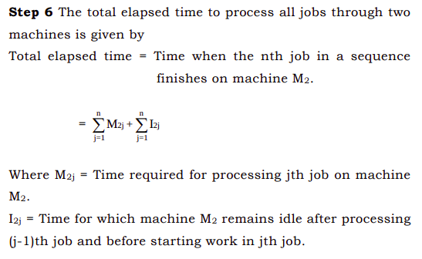
https://shodhganga.inflibnet.ac.in/bitstream/10603/11070/6/06_chapter2.pdf

Slide 16
Processing of n Jobs Through Two Machines​
Find the sequence that minimizes the total elapsed time required to complete the following jobs.
Calculate idle time for machines.
No. of jobs | 1 | 2 | 3 | 4 | 5 | 6
Machine A | 4 | 8 | 3 | 6 | 7 | 5
Machine B | 6 | 3 | 7 | 2 | 8 | 4
jobs | Machine A |  | Machine B

Slide 17
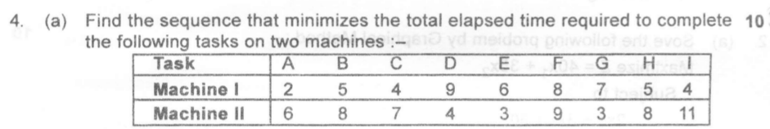
http://ecoursesonline.iasri.res.in/mod/resource/view.php?id=90031

Slide 18
Processing of n Jobs Through Three Machines​
No. of jobs | 1 | 2 | 3 | 4 | 5
Machine A | 8 | 10 | 6 | 7 | 11
Machine B | 5 | 6 | 2 | 3 | 4
Machine C | 4 | 9 | 8 | 6 | 5
a) The minimum processing time on machine A ≥ the maximum processing time on machine B.
b) The minimum processing time on machine C ≥ the maximum processing time on machine B.
The method is to replace the problem by an equivalent problem involving n jobs and two machines. These two fictitious machines are denoted by G and H and the corresponding time G_{i} and H_{i} are defined by
_{Gi = Ai + Bi and Hi = Bi + Ci}

Slide 19
jobs | Machine A |  | Machine B

Slide 20
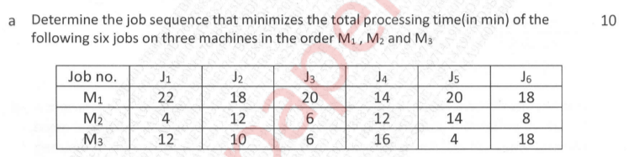
a) The minimum processing time on machine A ≥ the maximum processing time on machine B.
b) The minimum processing time on machine C ≥ the maximum processing time on machine B.
The method is to replace the problem by an equivalent problem involving n jobs and two machines. These two fictitious machines are denoted by G and H and the corresponding time G_{i} and H_{i} are defined by
_{Gi = Ai + Bi and Hi = Bi + Ci}

Slide 21
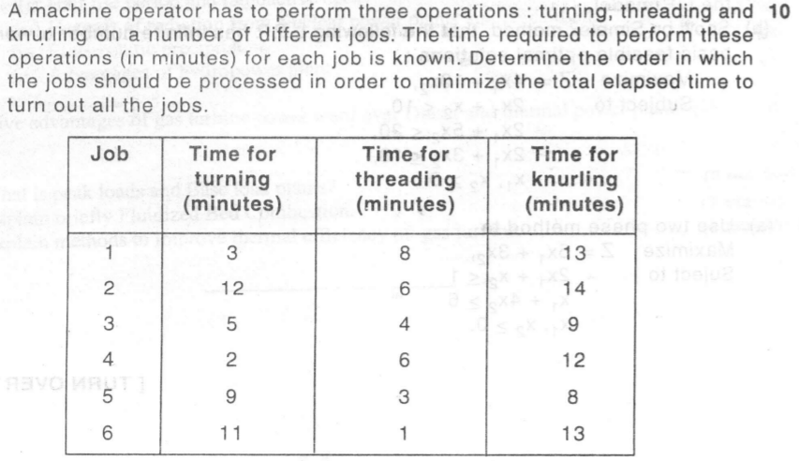

Slide 22
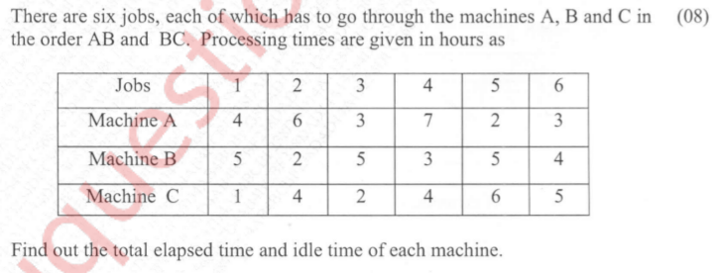

Slide 23

http://print-graph-paper.com/virtual-graph-paper

Slide 24
Processing of n Jobs Through m Machines​
Jobs | 1 | 2 | 3 | 4
m/c A | 7 | 6 | 5 | 8
m/c B | 5 | 6 | 4 | 3
m/c C | 2 | 4 | 5 | 3
m/c D | 3 | 5 | 6 | 2
m/c E | 9 | 10 | 8 | 6

